Slide 1
Pliable systems architecture
Daniël Joubert

Slide 2

Definition
Pliable
Easily bend; flexible
Easily influenced
Keynote: mailable
Software: change
Notes:
Let me dive into our ad units a little bit more. Our Branded Pins are like a digital store sign, great for location awareness of your nearby restaurants. A user can interact with the pin, in this case a Portillo’s, which then shows them an expanded ad. Here, restaurants can show offers and limited time offers, after which Wazers can directly drive to the location and their route will be automatically adjusted.

Slide 3
A Story of Change
2013 Vehicle telemetry platform (IoT data relating to vehicles)
Notes:
Let me dive into our ad units a little bit more. Our Branded Pins are like a digital store sign, great for location awareness of your nearby restaurants. A user can interact with the pin, in this case a Portillo’s, which then shows them an expanded ad. Here, restaurants can show offers and limited time offers, after which Wazers can directly drive to the location and their route will be automatically adjusted.

Slide 4
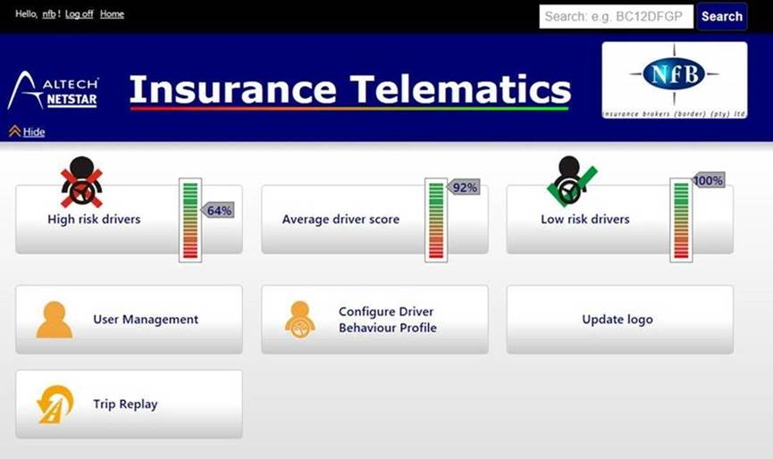
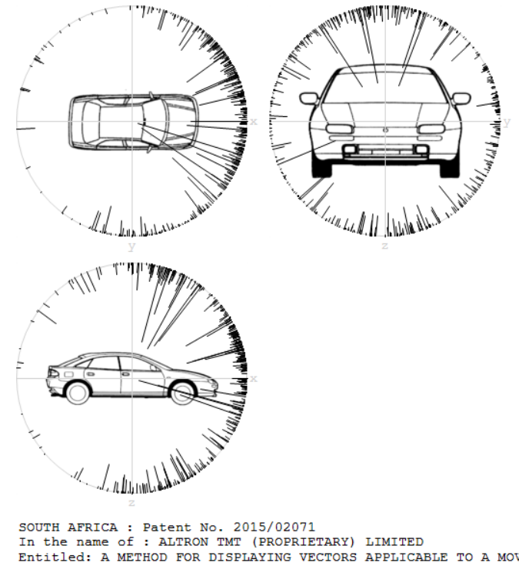
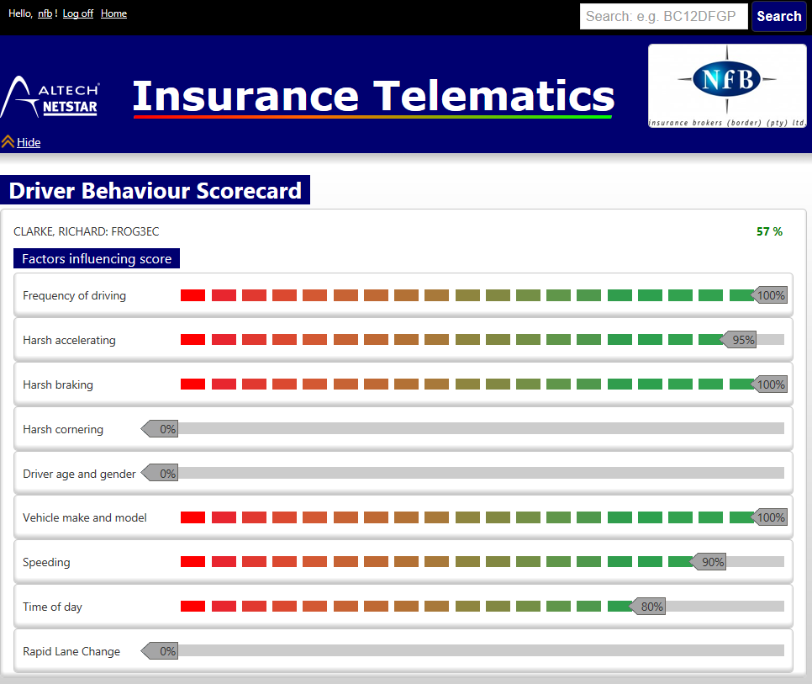
A Story of Change
2013 – Ventured into insurance telematics
Driver scoring, accident reconstruction report
Notes:
Let me dive into our ad units a little bit more. Our Branded Pins are like a digital store sign, great for location awareness of your nearby restaurants. A user can interact with the pin, in this case a Portillo’s, which then shows them an expanded ad. Here, restaurants can show offers and limited time offers, after which Wazers can directly drive to the location and their route will be automatically adjusted.

Slide 5
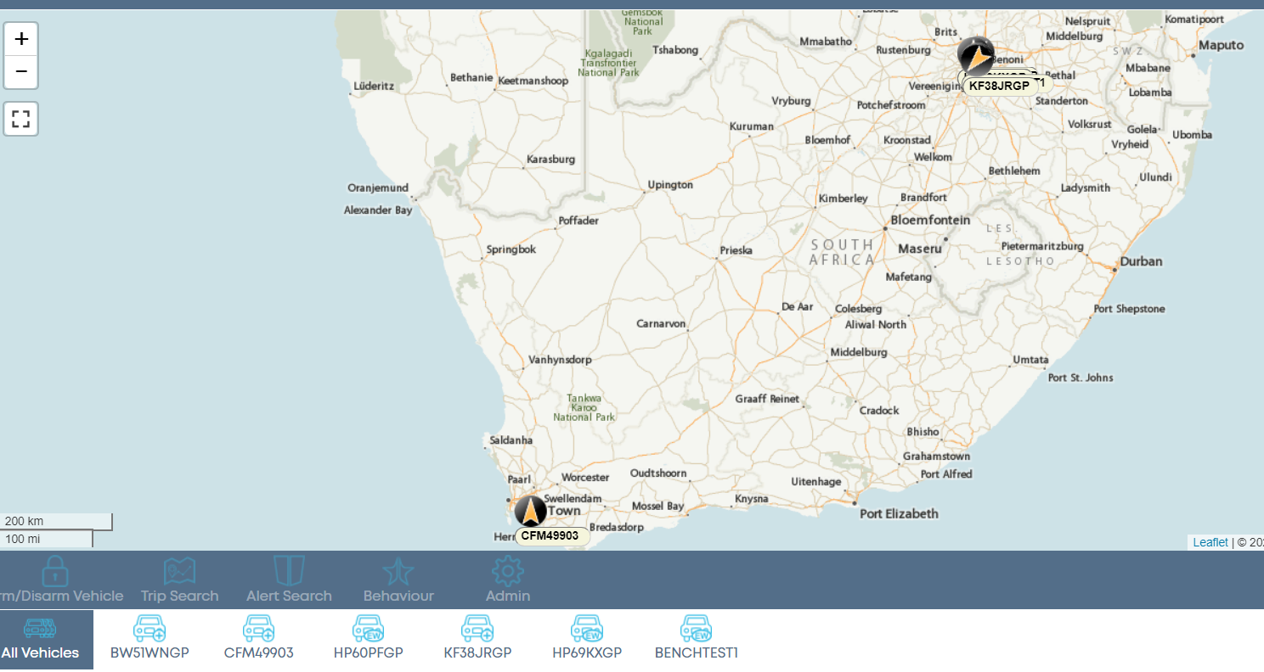
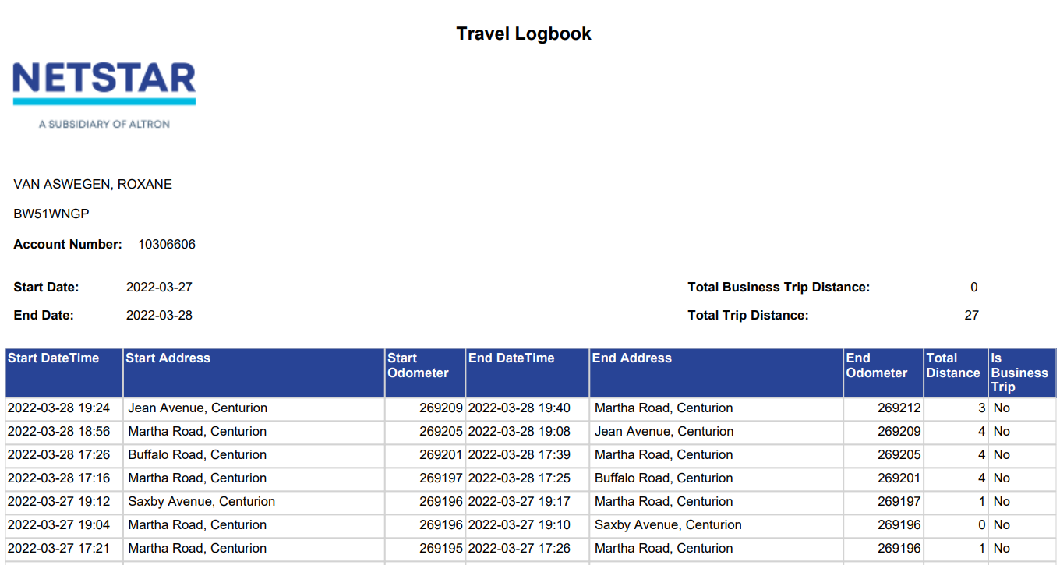
A Story of Change
2014 – Ride sharing, driver score gamification
Self help signup.
2015 – Replace ORM from Linq2Sql with our own
Average SQL read and write time from 100ms to 5ms
Reduced CPU time
2016 – Family fleet / Young Professional
Travel logbook
Mobile applications
Notes:
Let me dive into our ad units a little bit more. Our Branded Pins are like a digital store sign, great for location awareness of your nearby restaurants. A user can interact with the pin, in this case a Portillo’s, which then shows them an expanded ad. Here, restaurants can show offers and limited time offers, after which Wazers can directly drive to the location and their route will be automatically adjusted.

Slide 6
A Story of Change
2018 – Mom and Pop shop – Butcher, Baker and Biltong Maker
Work Items
2019 – Add Malaysia Partner
2020 – In vehicle Wi-Fi, with self help bulk Wi-Fi data purchase
2021 – Add Motor Dealers, move platform from Midrand data centre to Microsoft Azure ZA North data centre
2022 – Add European Bikes
2022 – SMB Fleets
Notes:
Let me dive into our ad units a little bit more. Our Branded Pins are like a digital store sign, great for location awareness of your nearby restaurants. A user can interact with the pin, in this case a Portillo’s, which then shows them an expanded ad. Here, restaurants can show offers and limited time offers, after which Wazers can directly drive to the location and their route will be automatically adjusted.

Slide 7
Where are we Today
220K Active Users
360K Actively Monitored Vehicles
90M records daily
Notes:
Let me dive into our ad units a little bit more. Our Branded Pins are like a digital store sign, great for location awareness of your nearby restaurants. A user can interact with the pin, in this case a Portillo’s, which then shows them an expanded ad. Here, restaurants can show offers and limited time offers, after which Wazers can directly drive to the location and their route will be automatically adjusted.

Slide 8
Change
There is always a skew between what was planned and how the software is actually used.
Want more features.
Environment change, e.g. services we using
Hosting environment - data centre / servers 2 docker
Usage change - more users / how the service is consumed
Always maintenance – e.g. Libraries that become outdated
Notes:
Let me dive into our ad units a little bit more. Our Branded Pins are like a digital store sign, great for location awareness of your nearby restaurants. A user can interact with the pin, in this case a Portillo’s, which then shows them an expanded ad. Here, restaurants can show offers and limited time offers, after which Wazers can directly drive to the location and their route will be automatically adjusted.

Slide 9
Agile
Agile – embrace change
Software and architecture should also embrace change
Notes:
Let me dive into our ad units a little bit more. Our Branded Pins are like a digital store sign, great for location awareness of your nearby restaurants. A user can interact with the pin, in this case a Portillo’s, which then shows them an expanded ad. Here, restaurants can show offers and limited time offers, after which Wazers can directly drive to the location and their route will be automatically adjusted.

Slide 10
Things that makes changes difficult
Complexity / Technical debt
Testing
System Visibility (Monitoring, Logging, Tracing)
Release process
Scale
Notes:
Let me dive into our ad units a little bit more. Our Branded Pins are like a digital store sign, great for location awareness of your nearby restaurants. A user can interact with the pin, in this case a Portillo’s, which then shows them an expanded ad. Here, restaurants can show offers and limited time offers, after which Wazers can directly drive to the location and their route will be automatically adjusted.

Slide 11
Managing Change
Microservices
Notes:
Let me dive into our ad units a little bit more. Our Branded Pins are like a digital store sign, great for location awareness of your nearby restaurants. A user can interact with the pin, in this case a Portillo’s, which then shows them an expanded ad. Here, restaurants can show offers and limited time offers, after which Wazers can directly drive to the location and their route will be automatically adjusted.

Slide 12
Microservices
Notes:
Let me dive into our ad units a little bit more. Our Branded Pins are like a digital store sign, great for location awareness of your nearby restaurants. A user can interact with the pin, in this case a Portillo’s, which then shows them an expanded ad. Here, restaurants can show offers and limited time offers, after which Wazers can directly drive to the location and their route will be automatically adjusted.

Slide 13
Demo 1
Testing in production
Testing streaming process
Obtaining data from API
Notes:
Let me dive into our ad units a little bit more. Our Branded Pins are like a digital store sign, great for location awareness of your nearby restaurants. A user can interact with the pin, in this case a Portillo’s, which then shows them an expanded ad. Here, restaurants can show offers and limited time offers, after which Wazers can directly drive to the location and their route will be automatically adjusted.

Slide 14
Code Implementation
Convert and Data Filter
Notes:
Let me dive into our ad units a little bit more. Our Branded Pins are like a digital store sign, great for location awareness of your nearby restaurants. A user can interact with the pin, in this case a Portillo’s, which then shows them an expanded ad. Here, restaurants can show offers and limited time offers, after which Wazers can directly drive to the location and their route will be automatically adjusted.

Slide 15
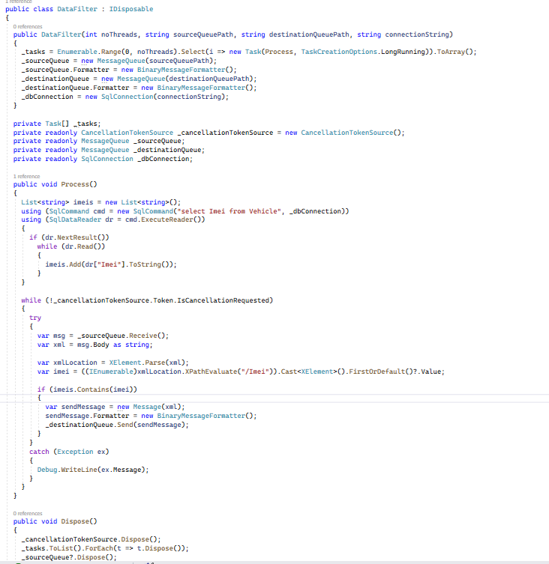
Demo 2
Notes:
Let me dive into our ad units a little bit more. Our Branded Pins are like a digital store sign, great for location awareness of your nearby restaurants. A user can interact with the pin, in this case a Portillo’s, which then shows them an expanded ad. Here, restaurants can show offers and limited time offers, after which Wazers can directly drive to the location and their route will be automatically adjusted.

Slide 16
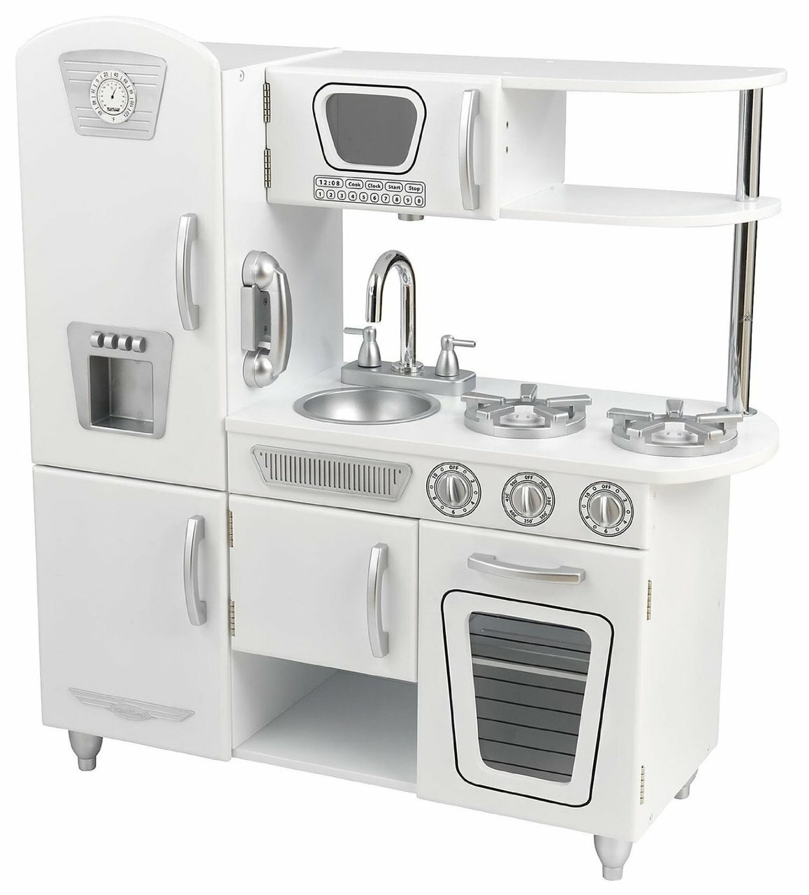
Antipattern
The God class
All knowing, seeing and omnipresent
Nearly impossible to test
Photo source: kindtokidz.com.au
Notes:
Let me dive into our ad units a little bit more. Our Branded Pins are like a digital store sign, great for location awareness of your nearby restaurants. A user can interact with the pin, in this case a Portillo’s, which then shows them an expanded ad. Here, restaurants can show offers and limited time offers, after which Wazers can directly drive to the location and their route will be automatically adjusted.

Slide 17
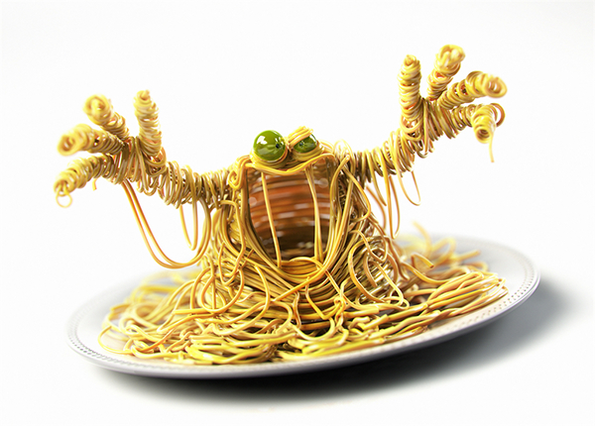
Antipattern
This type of code has the nasty habit of turning into a spaghetti code monster
Photo source: https://www.behance.net/gallery/25113905/Spaghetti-Monster
Notes:
Let me dive into our ad units a little bit more. Our Branded Pins are like a digital store sign, great for location awareness of your nearby restaurants. A user can interact with the pin, in this case a Portillo’s, which then shows them an expanded ad. Here, restaurants can show offers and limited time offers, after which Wazers can directly drive to the location and their route will be automatically adjusted.

Slide 18
Solution Principles
SOLID
Is misleadingly simple and difficult to master
5 years before being able to consistently applied and another 3 years to be proficient
Aspect Oriented Programming
Very generic
Took 2 years using interception to master
Programming language & technology agnostic
Notes:
Let me dive into our ad units a little bit more. Our Branded Pins are like a digital store sign, great for location awareness of your nearby restaurants. A user can interact with the pin, in this case a Portillo’s, which then shows them an expanded ad. Here, restaurants can show offers and limited time offers, after which Wazers can directly drive to the location and their route will be automatically adjusted.

Slide 19
SOLID
S – single responsibility principle
O – open close principle
L – Liskov substitution principle
I – Interface segregation principle
D – Dependency injection
Notes:
Let me dive into our ad units a little bit more. Our Branded Pins are like a digital store sign, great for location awareness of your nearby restaurants. A user can interact with the pin, in this case a Portillo’s, which then shows them an expanded ad. Here, restaurants can show offers and limited time offers, after which Wazers can directly drive to the location and their route will be automatically adjusted.

Slide 20
Demo 2
Notes:
Let me dive into our ad units a little bit more. Our Branded Pins are like a digital store sign, great for location awareness of your nearby restaurants. A user can interact with the pin, in this case a Portillo’s, which then shows them an expanded ad. Here, restaurants can show offers and limited time offers, after which Wazers can directly drive to the location and their route will be automatically adjusted.

Slide 21
Demo 3
Notes:
Let me dive into our ad units a little bit more. Our Branded Pins are like a digital store sign, great for location awareness of your nearby restaurants. A user can interact with the pin, in this case a Portillo’s, which then shows them an expanded ad. Here, restaurants can show offers and limited time offers, after which Wazers can directly drive to the location and their route will be automatically adjusted.

Slide 22
SOLID Discussion

Slide 23
SOLID Discussion

Slide 24
SOLID Discussion

Slide 25
SOLID Discussion

Slide 26
What have we learned so
Code does not care where the data it receive or requests comes from
Code does not care where data goes to next.
Code is simple to maintain
Business code focus on business requirements
Easy to reuse
Change require new separate code most of the time
No thigh coupling with specific technology
Notes:
Let me dive into our ad units a little bit more. Our Branded Pins are like a digital store sign, great for location awareness of your nearby restaurants. A user can interact with the pin, in this case a Portillo’s, which then shows them an expanded ad. Here, restaurants can show offers and limited time offers, after which Wazers can directly drive to the location and their route will be automatically adjusted.

Slide 27
Testing - Demo
If you can test it you can change it
If your code is difficult to test you are doing something wrong
Notes:
Let me dive into our ad units a little bit more. Our Branded Pins are like a digital store sign, great for location awareness of your nearby restaurants. A user can interact with the pin, in this case a Portillo’s, which then shows them an expanded ad. Here, restaurants can show offers and limited time offers, after which Wazers can directly drive to the location and their route will be automatically adjusted.

Slide 28
Aspect Orientated Programming
Approach to separate aspects in code.
E.g. separate business logic, logging and tracing
Notes:
Let me dive into our ad units a little bit more. Our Branded Pins are like a digital store sign, great for location awareness of your nearby restaurants. A user can interact with the pin, in this case a Portillo’s, which then shows them an expanded ad. Here, restaurants can show offers and limited time offers, after which Wazers can directly drive to the location and their route will be automatically adjusted.

Slide 29
Demo 4
AOP
Notes:
Let me dive into our ad units a little bit more. Our Branded Pins are like a digital store sign, great for location awareness of your nearby restaurants. A user can interact with the pin, in this case a Portillo’s, which then shows them an expanded ad. Here, restaurants can show offers and limited time offers, after which Wazers can directly drive to the location and their route will be automatically adjusted.

Slide 30
Demo 5
Notes:
Let me dive into our ad units a little bit more. Our Branded Pins are like a digital store sign, great for location awareness of your nearby restaurants. A user can interact with the pin, in this case a Portillo’s, which then shows them an expanded ad. Here, restaurants can show offers and limited time offers, after which Wazers can directly drive to the location and their route will be automatically adjusted.

Slide 31
Outcome
Code do not need to be littered with logging and tracing
Logging and tracing providers can be changed without touching the rest of the code base
Notes:
Let me dive into our ad units a little bit more. Our Branded Pins are like a digital store sign, great for location awareness of your nearby restaurants. A user can interact with the pin, in this case a Portillo’s, which then shows them an expanded ad. Here, restaurants can show offers and limited time offers, after which Wazers can directly drive to the location and their route will be automatically adjusted.

Slide 32
What has been demonstrated
Overall simplicity
Code more generic
Can use existing frameworks to get of the ground and then replace as needed
Reduce test surface and time spent testing for each change
Visibility on what the code is doing
How to make it easier to change your code deliver quickly and often
Notes:
Let me dive into our ad units a little bit more. Our Branded Pins are like a digital store sign, great for location awareness of your nearby restaurants. A user can interact with the pin, in this case a Portillo’s, which then shows them an expanded ad. Here, restaurants can show offers and limited time offers, after which Wazers can directly drive to the location and their route will be automatically adjusted.

Slide 33
Presentation Rating
Please rate me
https://www.devconf.co.za/rate
You can win a R6000 Wi-Fi enable robotic vacuum cleaner
Notes:
Let me dive into our ad units a little bit more. Our Branded Pins are like a digital store sign, great for location awareness of your nearby restaurants. A user can interact with the pin, in this case a Portillo’s, which then shows them an expanded ad. Here, restaurants can show offers and limited time offers, after which Wazers can directly drive to the location and their route will be automatically adjusted.

Slide 34
Q&A previous session
Q: Team mindset.
A: We spend a significant amount of time support software after it has been released
A: There is a difference between writing code for being easy to write and complete and making code easy to read, test and change.
Q: Is reflection used in this process and is it slow?
A: Yes reflection is used, but only initially to discover the class structure then to create classes using the intermediately language that is compiled which will run just as fast as normal c# code.
Q: Any tips on making debugging easy with microservices
A: We used services between our microservices such as queue, caching e.g. Redis. You can monitor these services and inject messages in the queues and cache to confirm that things are working.
Notes:
Let me dive into our ad units a little bit more. Our Branded Pins are like a digital store sign, great for location awareness of your nearby restaurants. A user can interact with the pin, in this case a Portillo’s, which then shows them an expanded ad. Here, restaurants can show offers and limited time offers, after which Wazers can directly drive to the location and their route will be automatically adjusted.

Slide 35
THANK
YOU

